Slide 1


Introduction to Data Science and Health Data
Instructor: Shri Harini Ramesh
April 28 – May 2, 2025
Slides are inspired from Wesley Willet’s, Polo Chau’s and Fateme Rajabiyazdi’s materials

Slide 2
When I say 'data,' what's the first thing that pops into your head?

Slide 3
What is Data?
Data = information we collect, measure, or observe
It’s around us all the time: clicks, steps, songs skipped, snaps posted
Not just numbers: includes words, photos, locations.

Slide 4
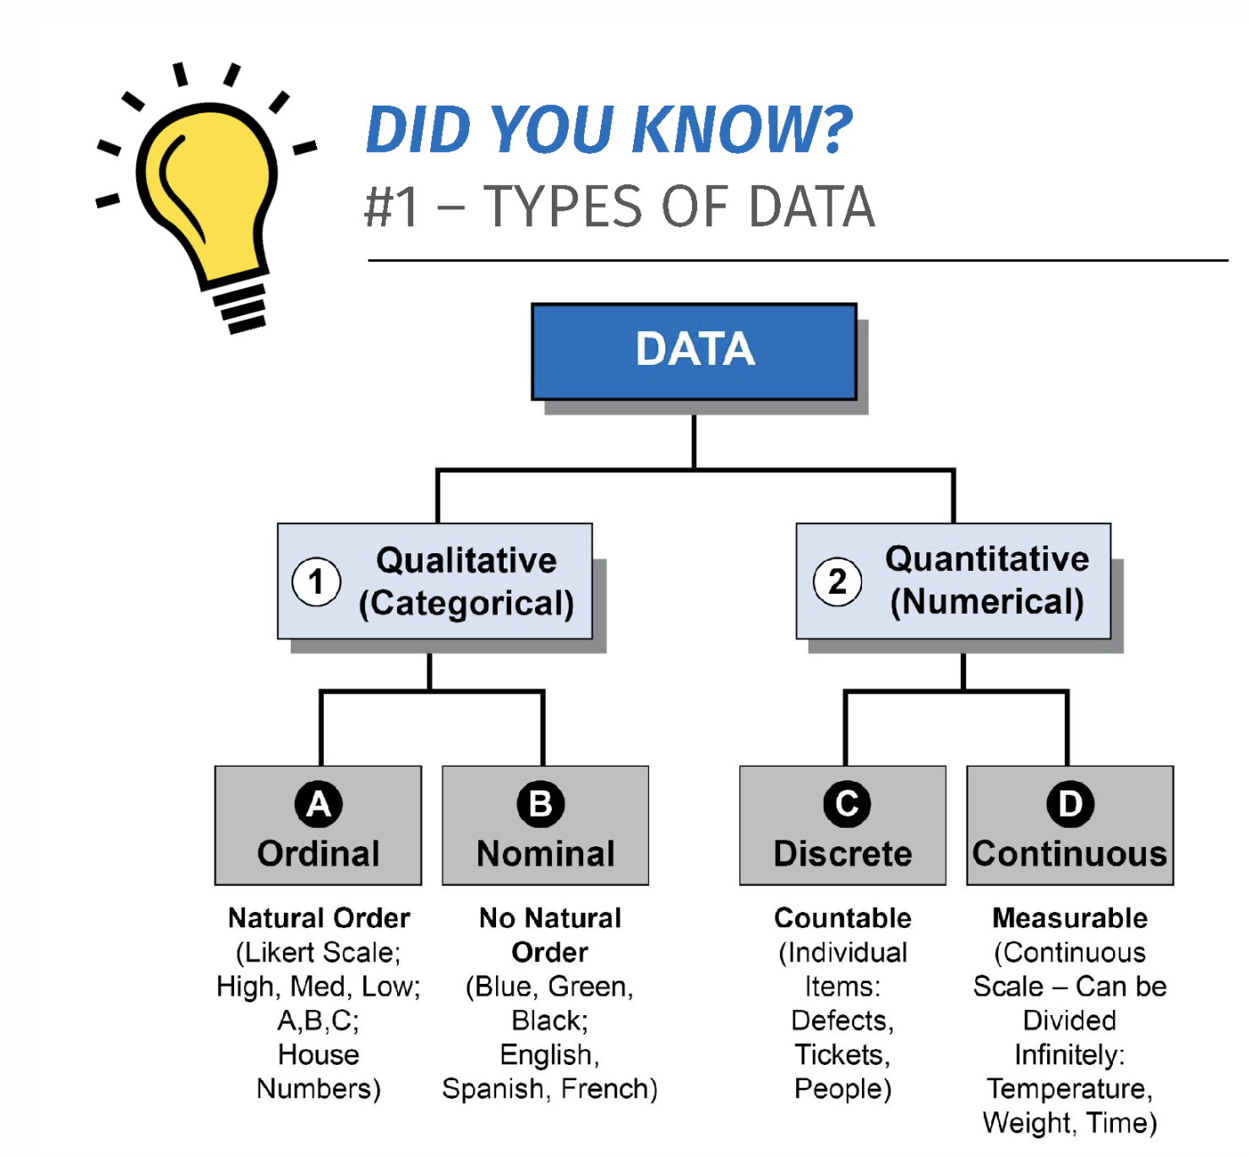

Slide 6
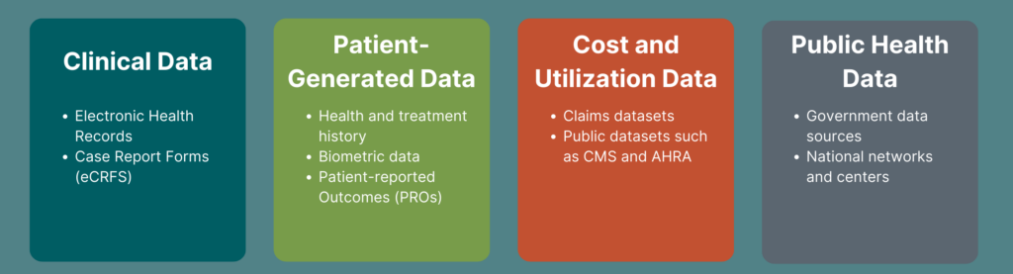
Health Data

Slide 7
Health Data

Slide 8
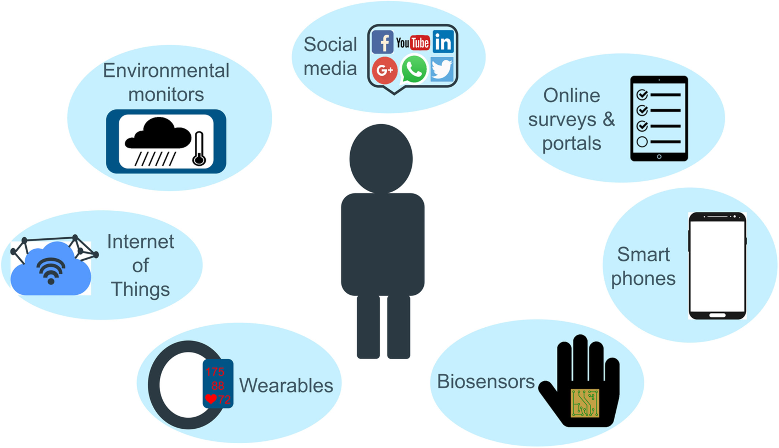

Slide 9
Let’s say I followed you around for a whole day. What kind of health-related information could I collect without even asking you anything?

Slide 10
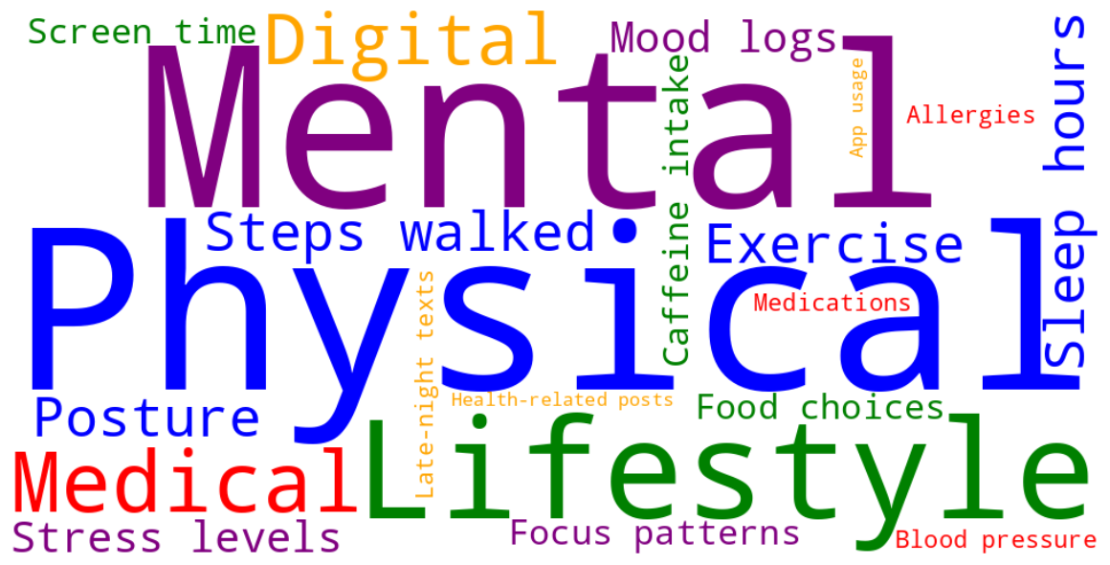

Slide 11
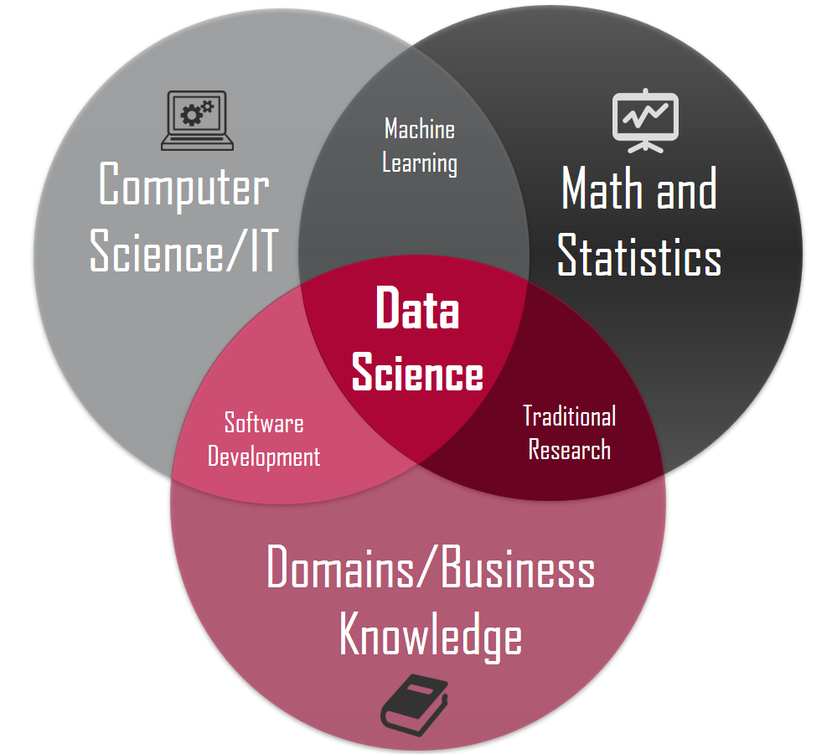
Data Science

Slide 12
Data Science Cycle
Ask a question
Collect data
Clean and organize
Analyze
Visualize
Interpret and act

Slide 13
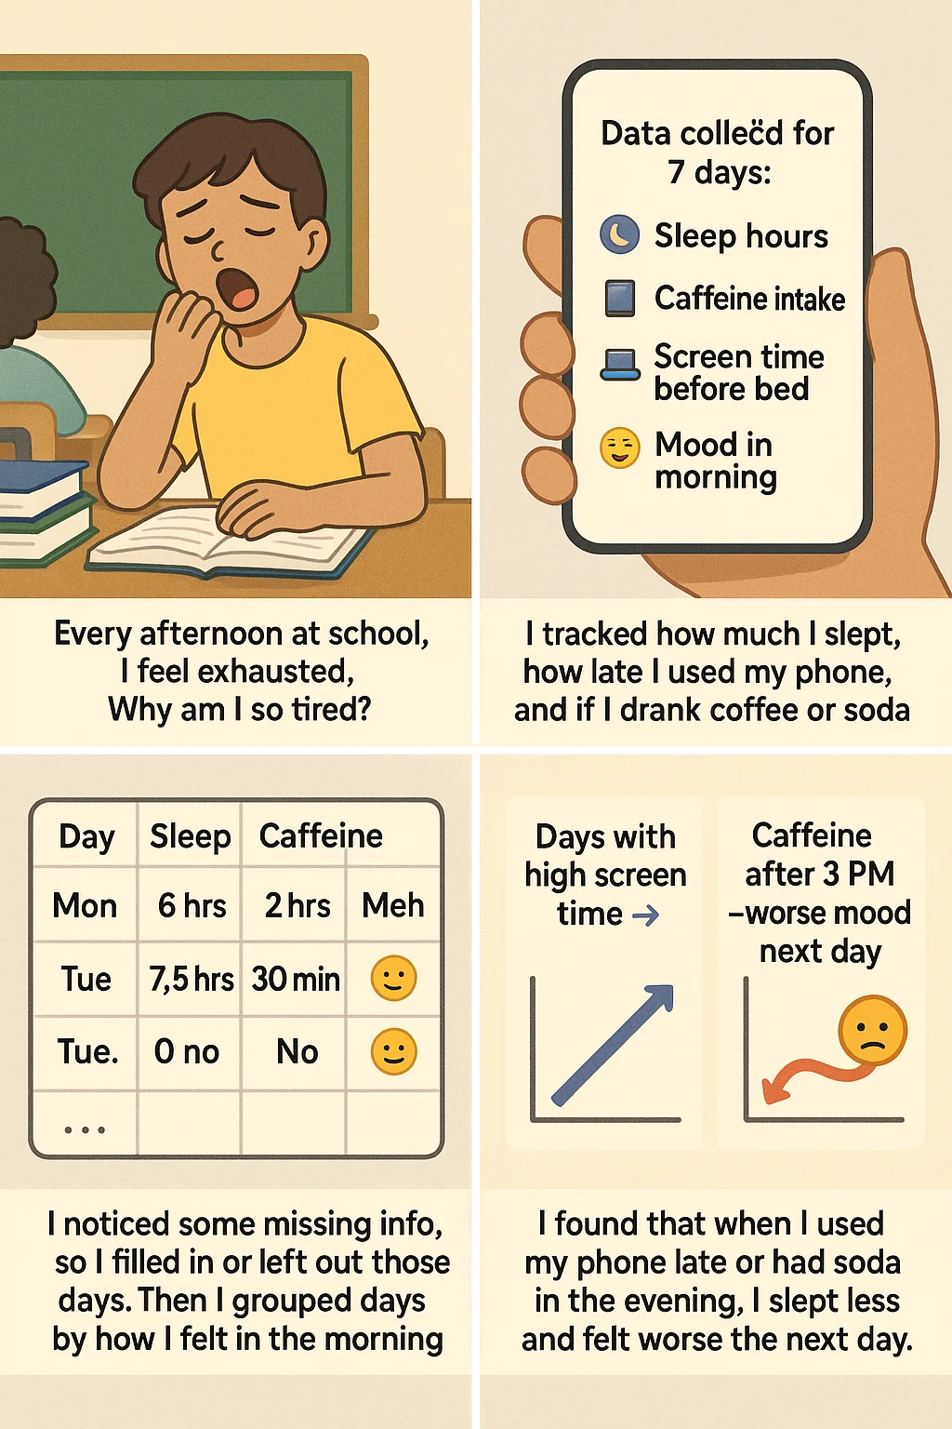
Data Science Use Cases

Slide 14
Data Science Use Cases
Question
Data collection
Data cleaning and organization
Visualization and interpretation

Slide 15
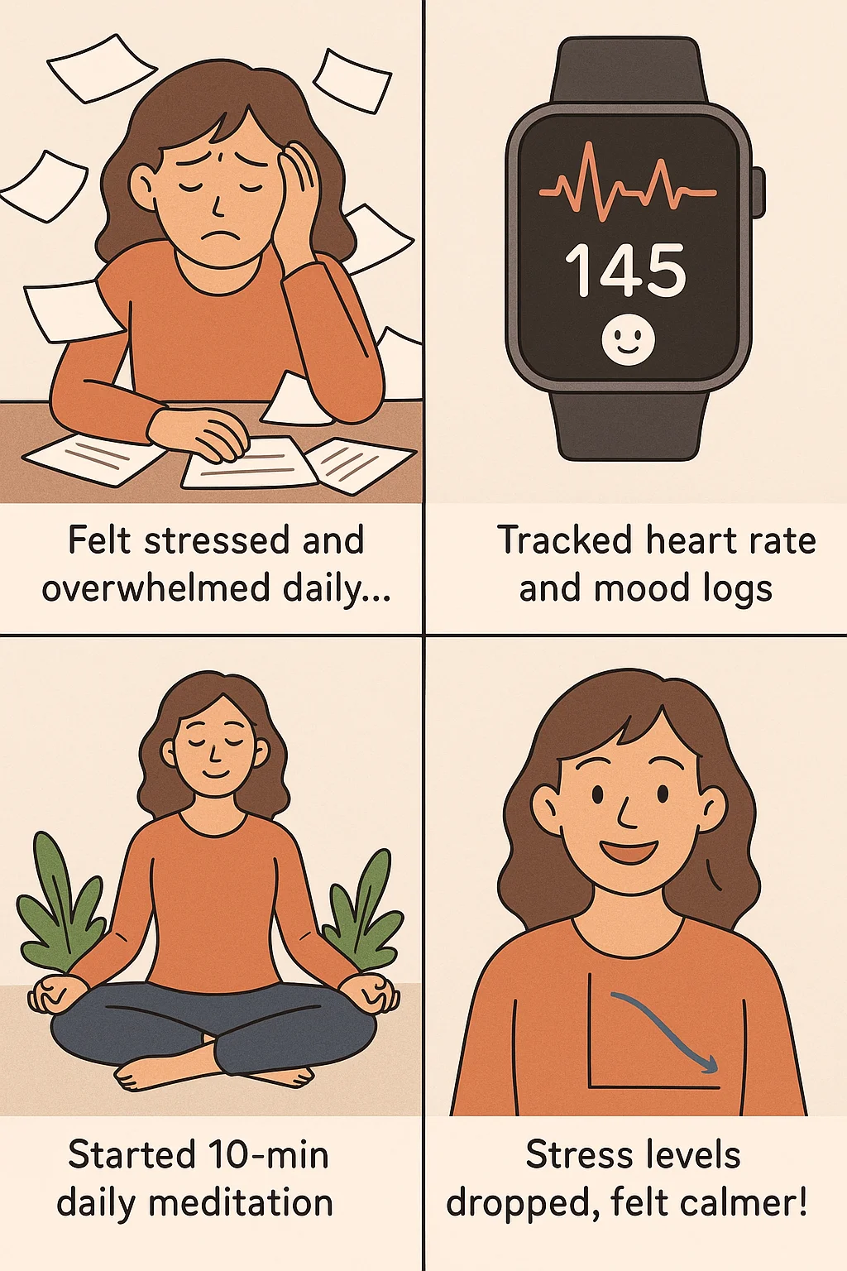
Data Science Use Cases

Slide 16

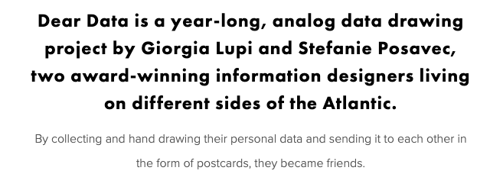

Slide 17
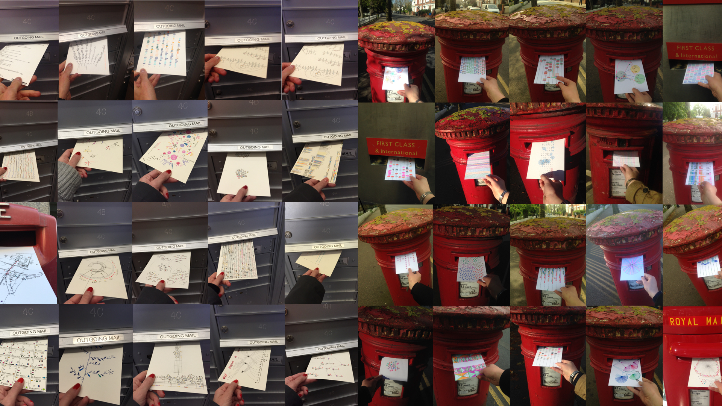

Slide 18
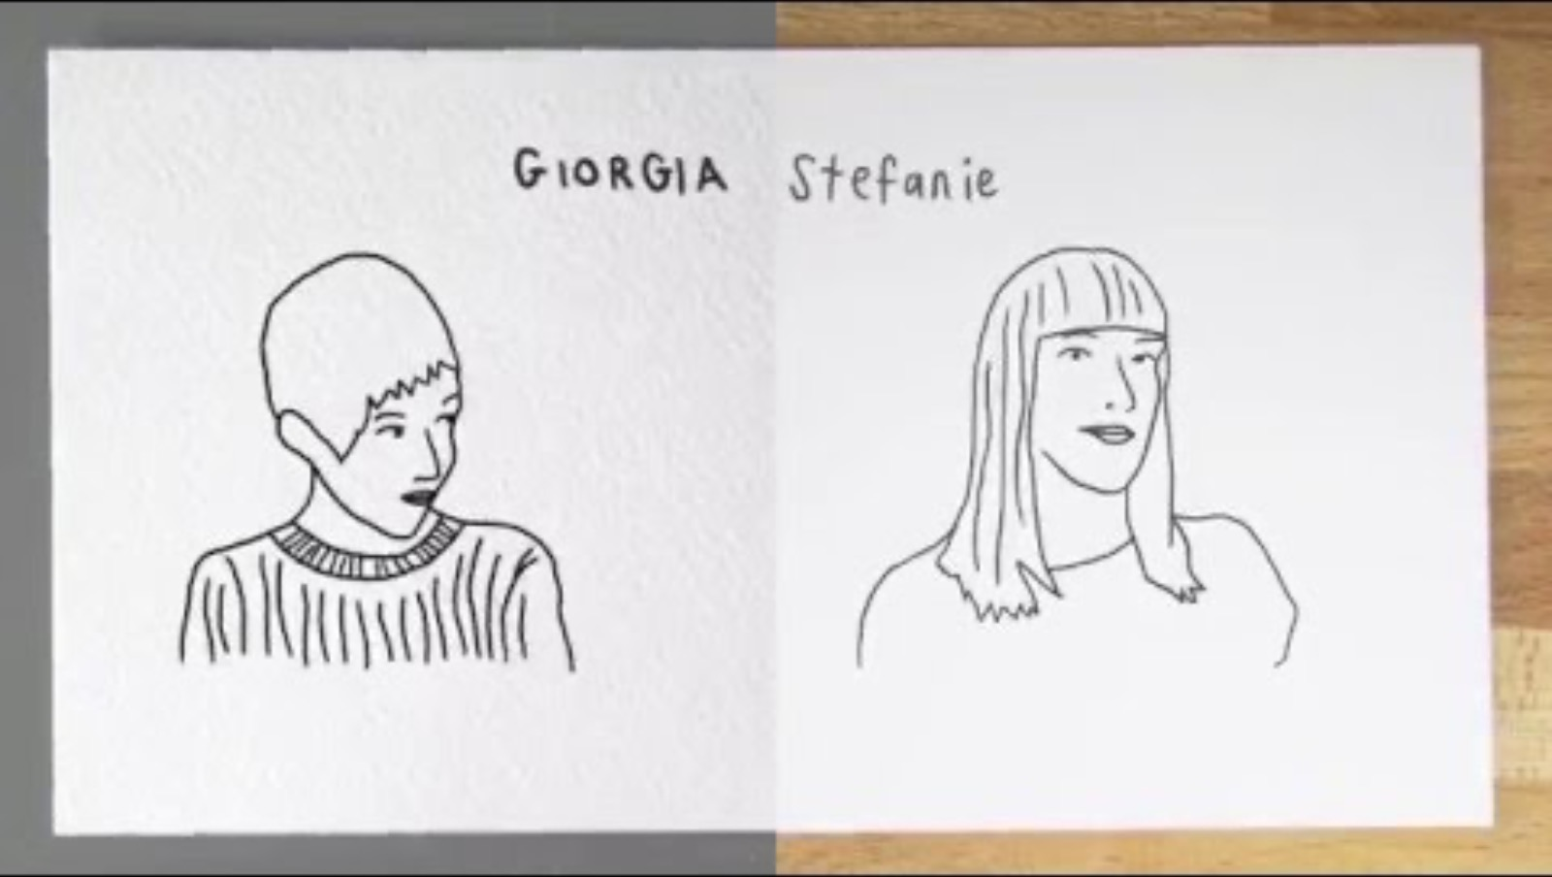

Slide 19
Data is All Around You! (Mini-Data Hunt Challenge)

Slide 20
Grab 3 things you brought today (from your bag or around you).
✍️ Fill out a mini postcard with the following questions:
What kind of data could this give?
What insights could this tell about you?
How could tracking this data help you make better choices?
📮 Swap with a Friend
Trade postcards with someone in the class.
Pick one item from their card and share something interesting you learned about them!

